Slide 1

第2章 上下文无关文法
本章内容及要求：
上下文无关文法CFG, 上下文无关的语言CFL
  Regular Language can be described by CFG (RL ⊂ CFL)
  Terminology related to CFG
    Leftmost Derivation, Ambiguity, Chomsky Normal Form (CNF)
    Converting a CFG into CNF
下推自动机 PDA
  An NFA equipped with a stack
  Power of CFG = Power of PDA (In terms of describing a language)
非上下文无关语言 Non-CFL
  CFL pumping lemma
  Apply pumping lemma to show that some language are non-CFL
Closure properties of CFL

Slide 2
CFG & CFL
Give context-free grammars generating the following languages:
L1 = {a^{n}b^{p}|0 < p < n}.
L4 = a(ab*)*.

Slide 3
CFG & CFL
L1 = {a^{n}b^{p}|0 < p < n}.
Solution:
S->aT|aS
T->aTb|ab
L4 = a(ab*)*.
Solution:
S->aR
R->QR|ε
Q->aT
T->bT| ε

Slide 4
CFG & CFL
What is the language of this grammar? The alphabet is {a, b, c, d} and start symbol is T.
S -> aSb| ε
T ->S | cS | Sd
Solution:
Clearly, the language of S is a^{n}b^{n}. The symbol T pads S with either one c on the left, or one arbitrary d on the right. As such, the language of thisgrammar is
a^{n}b^{n} + ca^{n}b^{n} + a^{n}b^{n}d.

Slide 5
CFG & CFL
What is the language of this grammar? The alphabet is {a, b, c, d} and start symbol is T.
S -> Tb
T ->aaS | cd
Solution:
Substituting S into T, we get that
T -> aaTb |cd
As such, the language of this grammar is
a^{2n}cdb^{n}.

Slide 6
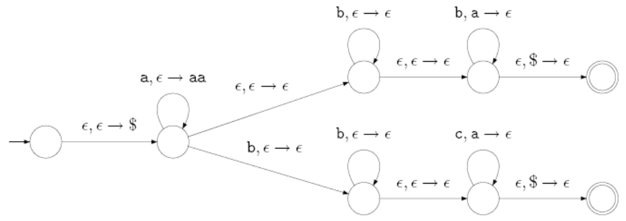



PDA & CFL
Give the language of the following PDA
Solution:

Slide 7
Converting CFG to PDA
For each of the following languages (with alphabet Σ= {a; b}) construct a pushdown automaton recognizing that language, following the general construction for converting a context-free grammar to a PDA:
The word w=babaabaabaaba and the grammar with start symbol S:
S ->AB | B
A -> BB | B
B ->CC | b
C -> aba

Slide 8
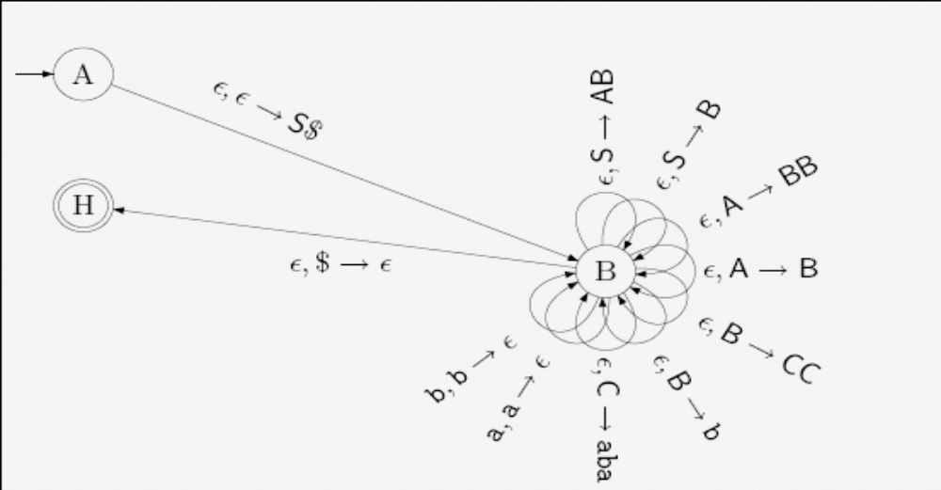
Converting CFG to PDA
The word w=babaabaabaaba and the grammar with start symbol S:
S ->AB | B
A -> BB | B
B ->CC | b
C -> aba
Solution:

Slide 9
Summary
Objectives
CFL, CFG=GFG with Chomsky=PDA
  Eg1+Eg1’: CFG design
  Eg2(CKG)+Eg3(ambiguity): Grammar analysis
  Eg4:palindrome (CFG and PDA)
  Eg5,6: PDA design
  Eg7: CFG->PDA
  Eg8: PDA->CFG

Slide 10
Example 1
Question( Grammar design)
Give a context free grammar for the following language. Briefly justify its correctness. L = {w ∈ {a, b}* | the number of a’s in w is at least the number of b’s in w}.
Solution 1:
we can make a slight modification to the example from class where we ensured that strings in our language have an equal number of a’s and b’s.
We’ll be generating the same number of X’s and Y ’s, and then choosing to fill some of the Y positions with ε instead of b, ensuring that there are at least as many a’s as b’s.

Slide 11
Example 1
Question( Grammar design)
Solution 1:
This is grammar G1 = ({S,A,B,X, Y }, {a, b},R1, S), where the set of rules R1 is defined below:
S → XB | Y A | ε
A → XS | Y AA | X
B → Y S | XBB | Y
X → a
Y → b
| ε

Slide 12
Example 1
Question( Grammar design)
Solution 2:
In a similar vein, we can tweak the grammar for generating equal number of a’s and b’s by simply adding in the rule B → ε to the grammar. This is grammar G2 =({S,A,B}, {a, b},R2, S), where the set of rules R2 is defined below:
S → aB | bA | ε
A → aS | bAA | a
B → bS | aBB | b | ε

Slide 13
Example 1
Question( Grammar design)
Solution 3:
Yet another correct solution has a completely different feel to it. Clearly it generates strings that contain as least as many a’s as b’s. This is grammar G3 = ({S}, {a, b},R3, S), where the set of rules R3 is defined below:
S → aS | Sa | aSbS | bSaS
| ε
Notes:
aabbab
SaSb

Slide 14
Example 1’
Question( Grammar design)
Give the CFGs generating the following languages:
The complement of the language {a^{n}b^{n} | n ≥ 0}
Solution:
A string in the complement of the language
{a^{n}b^{n} | n ≥ 0} must be in one of the following forms:
(i) contains a substring ba; or
(ii) equals to a^{i}b^{j} for some i ≠ j.
Accordingly, the CFG we use is as follows:

Slide 15
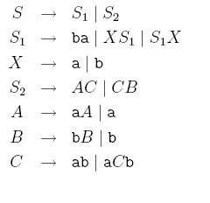
Example 1’
Question( Grammar design)
Give the CFGs generating the following languages:
The complement of the language {a^{n}b^{n} | n ≥ 0}
Solution:

Slide 16
Example 1
总结
CFL可以用CFG来定义（描述）
方法有4：
  复杂问题简化；
  正则语法的转换模式；
  根据语言中字符的个数关系；
  递归
δ(qi,a)=qj =>
qi->aqj
qi是接收状态 =>
qi->ε

Slide 17
Example 2
Question( Grammar Analysis 1- Chomsky Normal Form)
The variables are {S,N,M,Q,R} and the terminals are {x, p, q, b,w}. The start symbol is S.
S0 → S
S → NMQ|NM
N → xN
M → QpQ|Qp|pQ|p
Q → ab|R
R → w|Q
S0 → NMQ|NM
S → NMQ|NM
N → xN
M →QpQ|Qp|pQ|p
Q → ab|w
R → w|ab
S0 → S
S → NMQ
N → xN
M → QpQ
Q → ab|ε|R
R → w|Q
删除ε规则
删除unit规则
S0->S,Q->R,R->Q

Slide 18
Example 2
Question( Grammar Analysis 1- Chomsky Normal Form)
The variables are {S,N,M,Q,R} and the terminals are {x, p, q, b,w}. The start symbol is S.
S0 → NMQ|NM
S → NMQ|NM
N → xN
M →QpQ|Qp|pQ|p
Q → ab|w
R → w|ab
S0 → NY |NM
S → NY |NM
Y → MQ
N → XN
M → QZ|QP|PQ|p
Z → PQ
Q → AB|w
R → w|AB
X → x
A → a
B → b
P → p

Slide 19
Example 2
Summary( Grammar Analysis 1-Chomsky Normal Form)
Convert the following grammar into Chomsky Normal Form. Show separately the results of each intermediate step:
adding the new start symbol,
removing ε-transition,
removing unit rules,
finally modifying the right hand side of each rule to be either two variables or a single non-terminal.

Slide 20
Example 3
Question( Grammar Analysis 2-ambiguity)
Consider the grammar S ->aS | aSbS |ε
(a) Show that the grammar is ambiguous by finding a string in the language that has two different parse trees. For your string show the following: (i) two parse trees (ii) two leftmost derivations and (iii) two rightmost derivations.
Two leftmost derivations are given below.
S ⇒ aS ⇒ aaSbS ⇒ aabS ⇒ aab
S ⇒ aSbS ⇒ aaSbS ⇒ aabS ⇒ aab

Slide 21
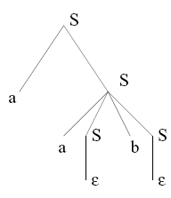
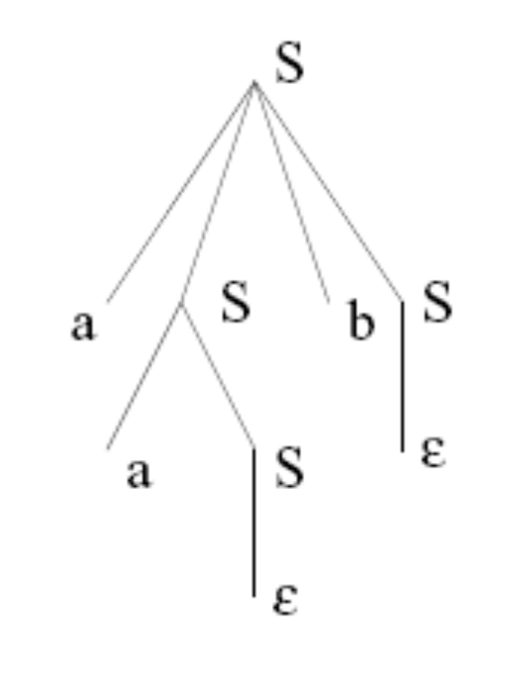
Example 3
Question( Grammar Analysis 2-ambiguity)
Consider the string aab. parse trees are given below.
Two rightmost derivations for the same string are given below.
S ⇒ aS ⇒ aaSbS ⇒ aaSb ⇒ aab
S ⇒ aSbS ⇒ aaSb ⇒ aab

Slide 22
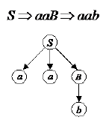
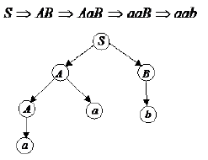

Example 3’
Question( Grammar Analysis 2-ambiguity)
Given the following ambiguous context free grammar
S → AB | aaB
A → a | Aa
B → b

Slide 23
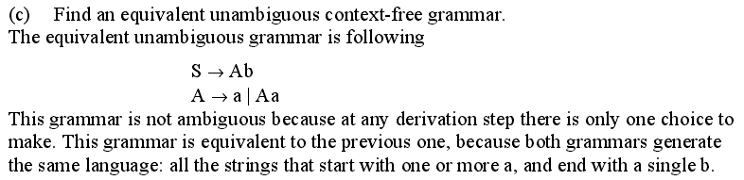
Example 3’
Question( Grammar Analysis 2-ambiguity)
Given the following ambiguous context free grammar
S → AB | aaB
A → a | Aa
B → b

Slide 24
Example 3
Question( Grammar Analysis 2-ambiguity)
Consider the grammar S ->aS | aSbS |ε
(b) Find an unambiguous grammar that accepts the same language.
Now we develop an unambiguous grammar for L. We are interested in strings w ∈ L of the form w = ax where x ∈ L. We observed above that such strings can be expressed as w = aybw’ where y,w’ ∈ L and further y has equal number of a’s and b’s. Let
L’ = {w ∈ L | w has equal number of a’s and b’s}. We focus on strings in L’.

Slide 25
Example 3
Question( Grammar Analysis 2-ambiguity)
Consider the grammar S ->aS | aSbS |ε
(b) Find an unambiguous grammar that accepts the same language.
First if w ∈ L’, then w = axb (why?). Note that x has equal number of a’s and b’s. Now there are two cases.
In the first case x ∈ L’.
In the second case, x ∈ L’ and using a reasoning, we can then look at z, the shortest prefix of x that contains more b’s than a’s. Then z = yb and we can write w = aybu where y, u ∈ L’. Thus we can write a grammar for L’−{ε} as given below.
E → aEb | aEbE | abE | ab

Slide 26
Example 3
Question( Grammar Analysis 2-ambiguity)
Consider the grammar S ->aS | aSbS |ε
(b) Find an unambiguous grammar that accepts the same language.
We add an additional rule E → abE to take care of the case in E → aEbE when the first E might have to lead to the empty string (this corresponds to the case that y = and z = b).
Now we claim that the above grammar is unambiguous for L’ − {ε}. The reason for this is the following.

Slide 27
Example 3
Question( Grammar Analysis 2-ambiguity)
Consider the grammar S ->aS | aSbS |ε
(b) Find an unambiguous grammar that accepts the same language.
If w = axb ∈ L’ then if x /∈ L’ then one has to use the rule E → aEbE as the first rule in the derivation of w. We can also claim that if x ∈ L’ then one cannot use E → aEbE as the first rule because EbE would generate a string ybw’ with y,w’ ∈ L’ with x = ybub where w’= ub; however x /∈ L’ because of the prefix yb. Now we have to also convince ourselves that in the case x /∈ L′ there cannot be two distinct derivations for w after the first rule E → aEbE.

Slide 28
Example 3
Question( Grammar Analysis 2-ambiguity)
Consider the grammar S ->aS | aSbS |ε
(b) Find an unambiguous grammar that accepts the same language.
To see this you have to convince yourselve that the only way to write w = aybw’ with y,w’ ∈ L’ is to use z = yb as the shortest prefix of x that has more b’s
than a’s. Thus the decomposition is unique.
Now we use the above to write an unambiguous grammar for L.
S0 → S | ǫ
S → E | EaS | Ea | aS | a
E → aEb | aEbE | abE | ab

Slide 29
Example 3
Question( Grammar Analysis 2-ambiguity)
Consider the grammar S ->aS | aSbS |ε
(b) Find an unambiguous grammar that accepts the same language.
If w = ax and x ∈ L then the first rule has to be S → aS. If x 6∈ L then either w ∈ L’ or w = w′y where w’ ∈ L’ and y ∈ S. However breaking up w as w’y would lead to potential ambiguity. Thus we look for w’ where w’ is the longest prefix of w such that w’∈ L’. The longest prefix w’ will satisfy the property that either w = w’ or w = w’ay where y ∈ L (do you
see why?). Thus we have demonstrated that given any w ∈ L there is a way to decompose it in unique fashion and each rule of S gives rise to one of those decompositions. We can then use induction to formally prove the unambiguity.

Slide 30
Example 4
Question (PDA design):
Give a formal description and the corresponding state diagram of a PDA that recognizes the language A = {w | 2#a(w) ≠ 3#b(w), w∈{a,b}*}, where #c(w) denotes the number of character c occurring in the word w.
We want to construct a PDA so that if
  the input string has 2#a(w) = 3#b(w), we reject it.
  Otherwise, we will accept it;

Slide 31
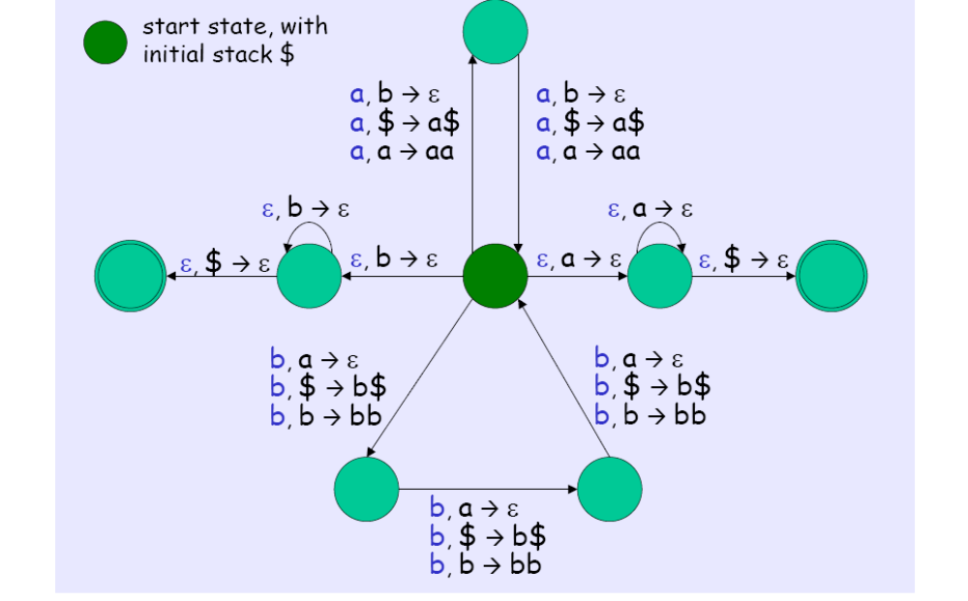
Example 4
Question:
The key idea of the PDA is to use the stack to keep track of how many as or bs are ’in extra’ (for 2#a(w) to match with 3#b(w)). To do so, we assign each a to worth 2 units, and each b to worth -3 units, and the stack keeps track of the ’net total’ as we process the string. It is easy to check that w is in A if and only if the net total after processing w is not 0 units.
ε
ε
ε
ε
ε
ε
ε
ε
ε

Slide 32
Example 5
Question (PDA design):
Design PDAs to recognize the following languages. For the PDA, give a state diagram and a brief explanation of how it works.
(a) L1 = {x1#x2#. . .#xk | k ≥ 2, each xi ∈ {a, b}∗, and for some i ≠ j, xi = x^{R}_{j}}.

Slide 33
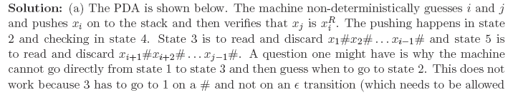
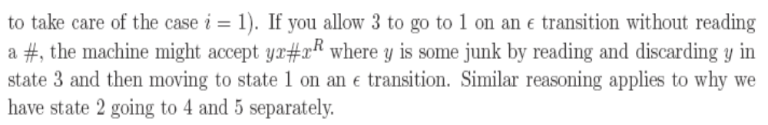
Example 5

Slide 34
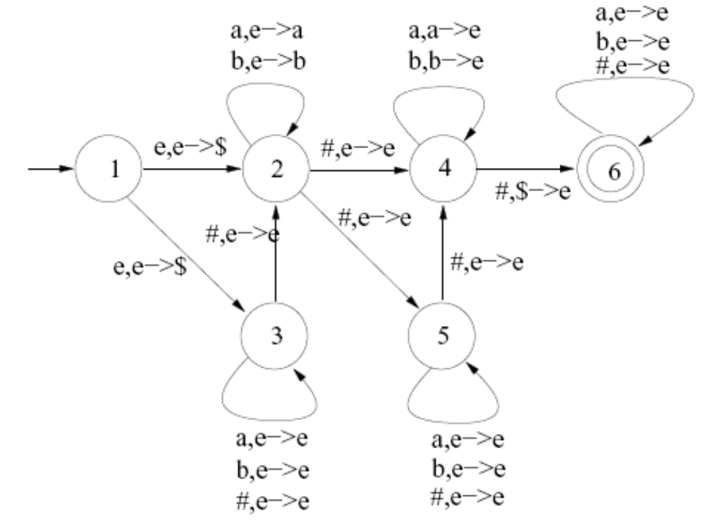
Example 5
x1#x2#. . .#xk

Slide 35
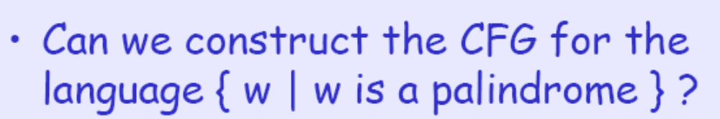
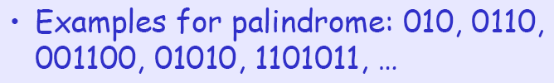
Example 6
Question:
CFG:
S → 0S0 | 1S1 | 0 | 1 | ε

Slide 36
Example 6
Question(palindrome)
In this case, we never know where the middle of the string is. To recognize these palindromes, the automaton must guess where the middle of the string is (i.e., is nondeterministic).
ε, ε→$
q₂
(1,0), ε→(1,0)
q₁
ε, (1,0)→ε
ε, $→ε
(1,0), (1,0)→ε
q₄
q₃

Slide 37
PDA example
Given the palindrome 011010110, the PDA needs to guess where the middle symbol is:
Stack: Guess Middle: Match remainder:
0 11010110
0 1 1010110
01 1 010110
011 0 10110
0110 1 0110
01101 0 110
011010 1 10
0110101 1 0
01101011 0
If some sequence of guesses leads to a complete parse of the input string, then the string is valid according to the grammar.

Slide 38
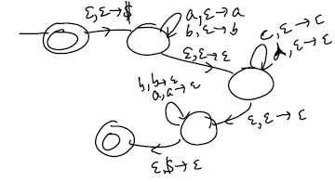
PDA example (补充)
L={wxw^{R}|w∈{a,b}*,x ∈{c,d}*}
CFG:
S->aSa | bSb | X
X->cX | dX|ε
PDA:
Γ={$,a,b}

Slide 39
Example 7
Question( CFG->PDA)
Professor Snape’s practical telepathy group is testing their new algorithms for consistently winning games of Rock-Paper-Scissors. As they are tested against human players, the programs generate logs of the games they have played, from which Professor Snape and his students can generate performance numbers. Each log file contains a list of games separated by semicolons. Each game is simply two symbols, representing the moves for the two players.
More precisely, the format of these log files is described by the following grammar with start
symbol G (for “game”). The alphabet = {r, p, s, ; }.
G → G;G | MM
M → r | p | s

Slide 40
Example 7
Question( CFG->PDA)
(a) A leftmost derivation for rp; ss is given below.
G ⇒ G;G ⇒ MM;G ⇒ rM;G ⇒ rp;G ⇒ rp;MM ⇒
rp; sM ⇒ rp; ss
(b) Give the state diagram for a PDA recognizing the same language as this grammar, using the general construction for converting a CFG to a PDA.

Slide 41
Example 7
Question( CFG->PDA)
A PDA that accepts the same language as the grammar is given below following the construction procedure in the text book. The first PDA top allows strings to be pushed onto the stack which can be simulated with extra states as shown in the second PDA.
G → G;G | MM
M → r | p | s

Slide 42
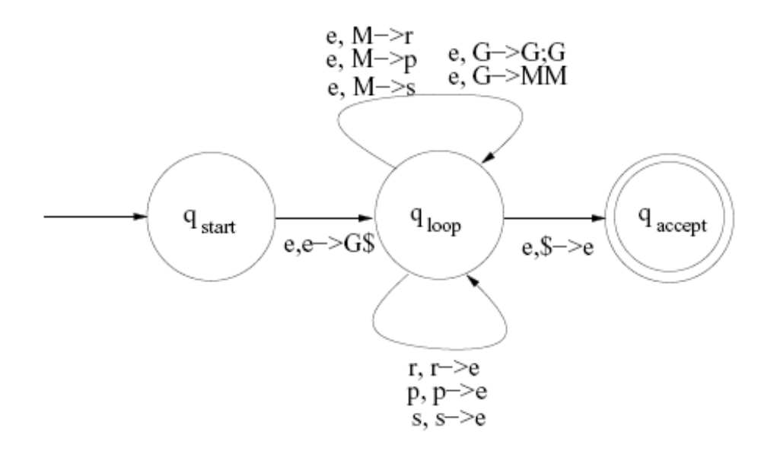
Example 7
G → G;G | MM
M → r | p | s
Question( CFG->PDA)
A PDA that accepts the same language as the grammar is given below following the construction procedure in the text book. The first PDA top allows strings to be pushed onto the stack which can be simulated with extra states as shown in the second PDA.

Slide 43
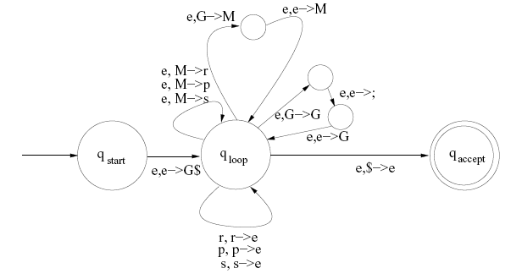
Example 7
G → G;G | MM
M → r | p | s
Question( CFG->PDA)
A PDA that accepts the same language as the grammar is given below following the construction procedure in the text book. The first PDA top allows strings to be pushed onto the stack which can be simulated with extra states as shown in the second PDA.

Slide 44
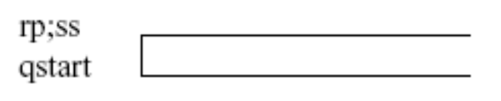
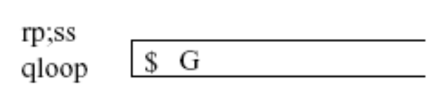
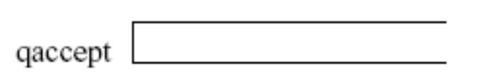
Example 7
G → G;G | MM
M → r | p | s

Slide 45
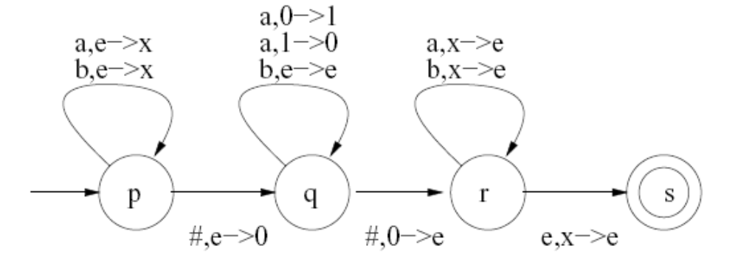
Example 8
Question( PDA->CFG)
Let M be the PDA whose state diagram is shown in the figure (e stands for ε). It recognizes
the language L = {x#y#z | x, y, z ∈ {a, b}∗, |x| > |z| and y has an even number of a’s}.
The stack alphabet is {0, 1, x}.

Slide 46
Example 8
Question( PDA->CFG)
(a) Put this PDA into the standard form for converting a PDA to a CFG,. Your transformation must ensure that the PDA has only one final state, cleans up its stack before accepting, and each state
either pushes or pops a symbol from but not both. Give a state diagram for the PDA .

Slide 47
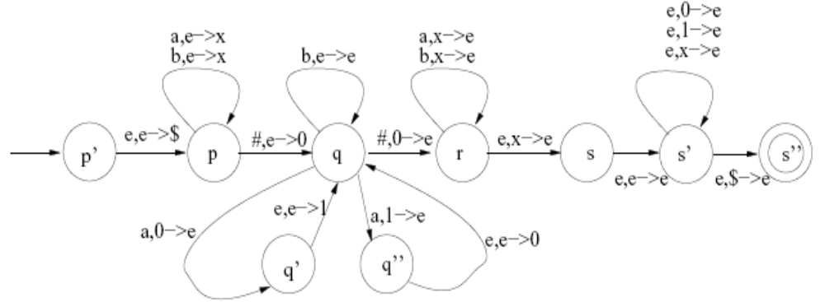
Example 8
The new start state p’ pushes $, a new stack symbol, on to the stack and goes to the old start state p. The state s’ cleans up the stack of the old machine and then removes $ and empties the stack to go to
the final state s’’. The states q’ and q’’ are used to simulate the transitions of q that both push and pop.

Slide 48
We will use some notation to keep the writing of rules manageable. Let Q = {p, q, r, s, p’, q’, q’’, s’, s’’}.
First we give the rules with Aps on the left hand side. The second type of rule gives the following rules; there are three transitions from p that push and there is only one transition into s that pops and we match push and pop transitions on the same stack character (in this case only x). Aps → aApr,Aps → bApr
Example 8

Slide 49
The first type generates many rules but we can write them compactly as follows. Aps → ApuAus (u ∈ Q)
The third type of rule does not apply for Aps. The rules for Aqq are below. No first type rules are generated.
Aqq → AquAuq (u ∈ Q)
Aqq → e
The rules for Aqs are below. No first type or third type rules are generated. Aqs → AquAus u ∈ Q
Example 8

Slide 50
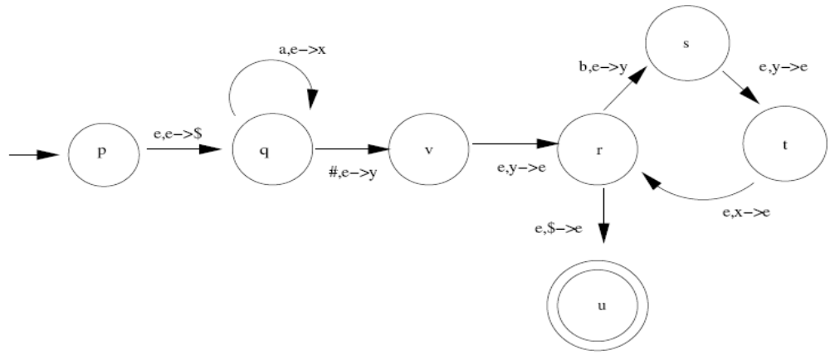
补充Example(PDA->CFG)
For the PDA whose state diagram is shown below (e on the transitions means ε), give all rules with left hand side Aqr that would be produced by the automatic procedure for converting to a CFG. (Notice that this PDA is already in standard format.)

Slide 51

补充Example(PDA->CFG)
Solution: As we stressed in class review, the procedure is mechanical and follows the rules given in Sipser. The rules for Aqr are the following:
Aqr -> #Avv | aAqt
Aqr-> AqxAxr, for each x ∈ {p; q; r; s; t; u; v}

Slide 52
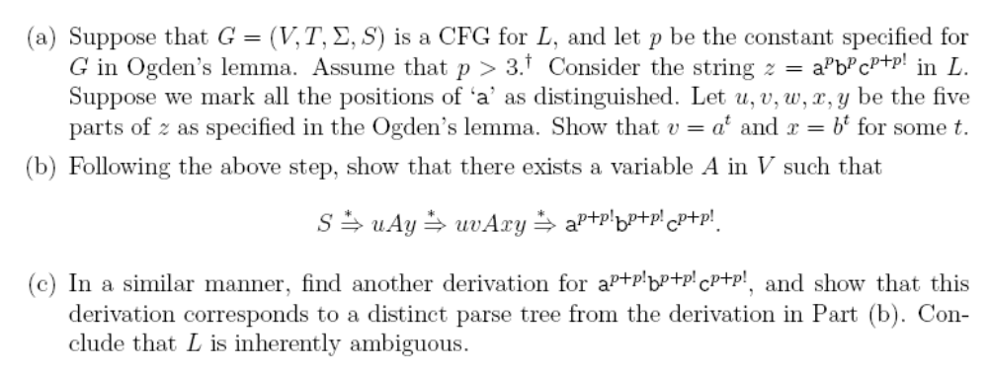
Inherently Ambiguous Example

Slide 53
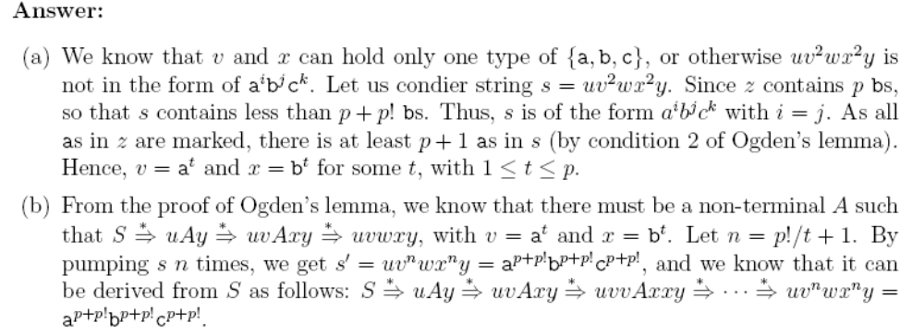
Inherently Ambiguous Example

Slide 54
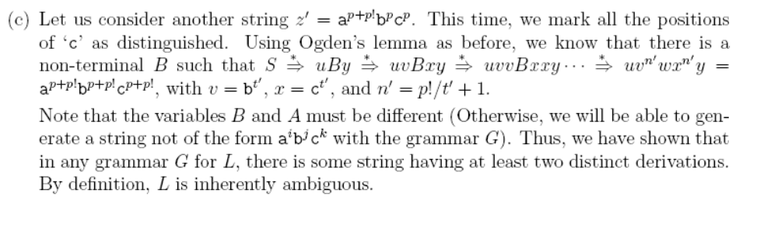
Inherently Ambiguous Example

